Slide 1
2018 Counselor Expense Report Process Field Counselor Training Module

Slide 2

Advantages of New Expense Process
Reduced expense to the Counselor. No Postage! No Mail!
Significantly “speeds up” the processing time from submission to approval to direct deposit.
Electronic email trail of all expenses. Creates a permanent record of your expense reports.
Can be completed all on your mobile device.
Paperless!

Slide 3
New 2018 Counselor Expense Process
STEP 2
STEP 3
STEP 4
STEP 5
STEP 1
For each assigned case, the Enrollment Service Manager will send out a link to the counselor team. Counselor completes the report, attaches receipts & submits.
WFM reviews and approves expense reports. All documentation will be sent to Accounts Payable (AP) / Finance.
AP / Finance reviews expenses for accuracy and compliance with Aon reimbursement policies. Any noncompliant expenses will be sent to the WFM team for review.
After review, AP / Finance enters expenses for each counselor into WorkDay; followed by an automated email sent directly to the WFM Director for final approval.
PLEASE NOTE –
All Reimbursements take approximately 1-2 business days to hit direct deposit accounts after Step 5 has been completed.
After the WFM Director approves the expenses, a payment is processed to the counselor via direct deposit only.

Slide 4
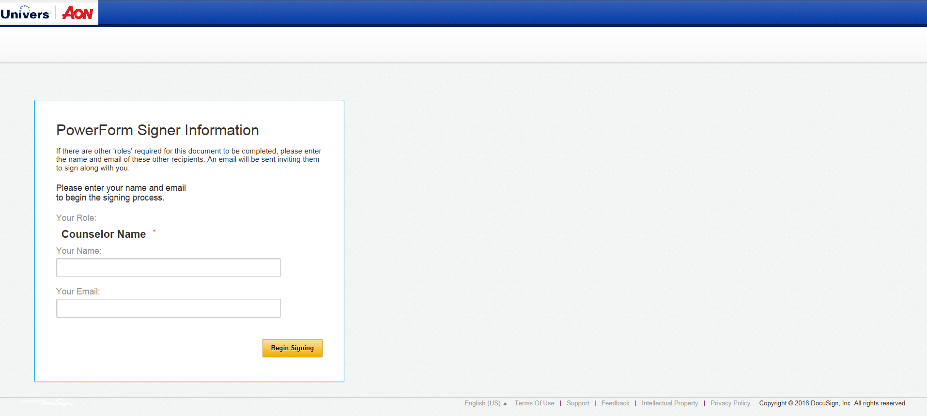
Starting a New Expense Report - Login
Click on the link provided: 2018 Expense Report
Enter your name and email address
Click on “Begin Signing” (this will generate an email to indicate you have started a new expense report submission)
Enter your
Name & Email address

Slide 5
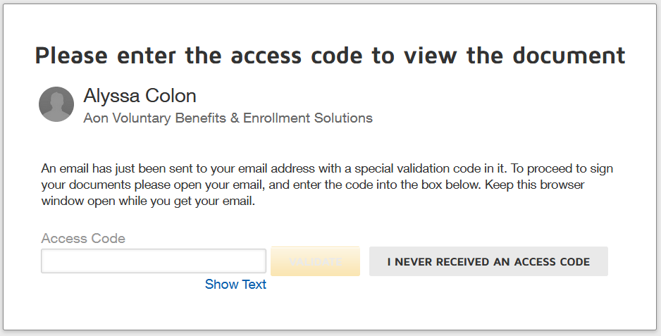
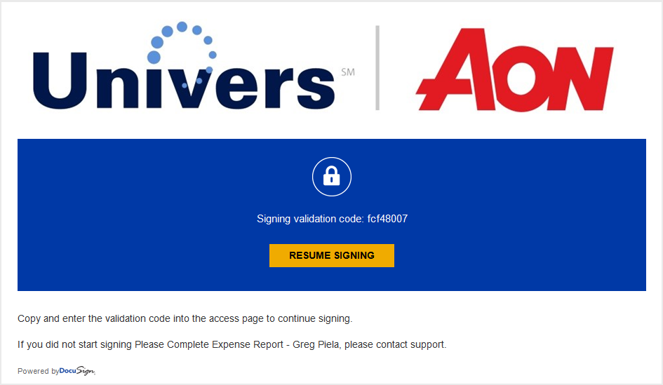
Starting a New Expense Report – Validation Code
4. You will then be prompted to enter an access code. The code will be sent via email.
5. You will receive an email, similar to the example on the right. It will contain the validation code. Enter code and be aware that it is case sensitive.

Slide 6


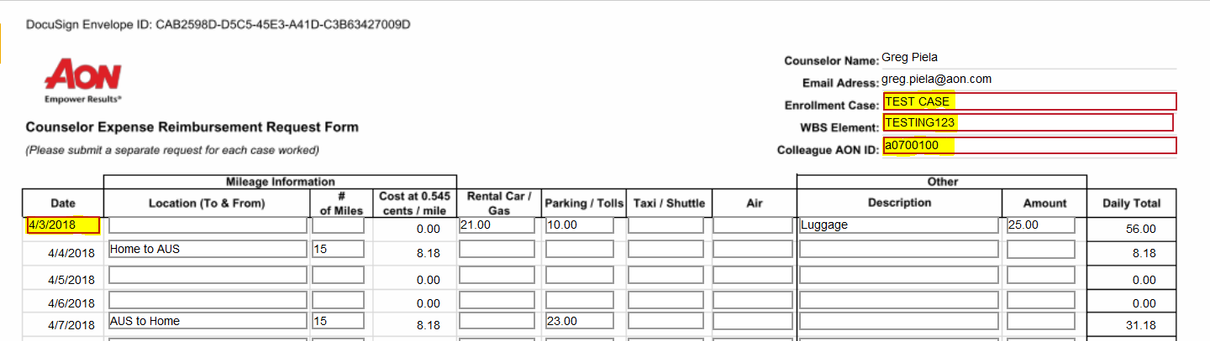
Starting a New Expense Report – Entering Expenses
6. Check & Agree to the Electronic Record & Signature Disclosure.
7. Click Continue to the right
Once you begin, please note the following. You will need to:
Enter the name of the Case you are working on (Example: TEST CASE)
Enter the WBS Element Code. This will be provided to you via email. It is case specific.
Your Aon EEID
At this point you can start entering in expenses starting with the earliest date you incurred an expense (MM/DD/YYYY)

Slide 7
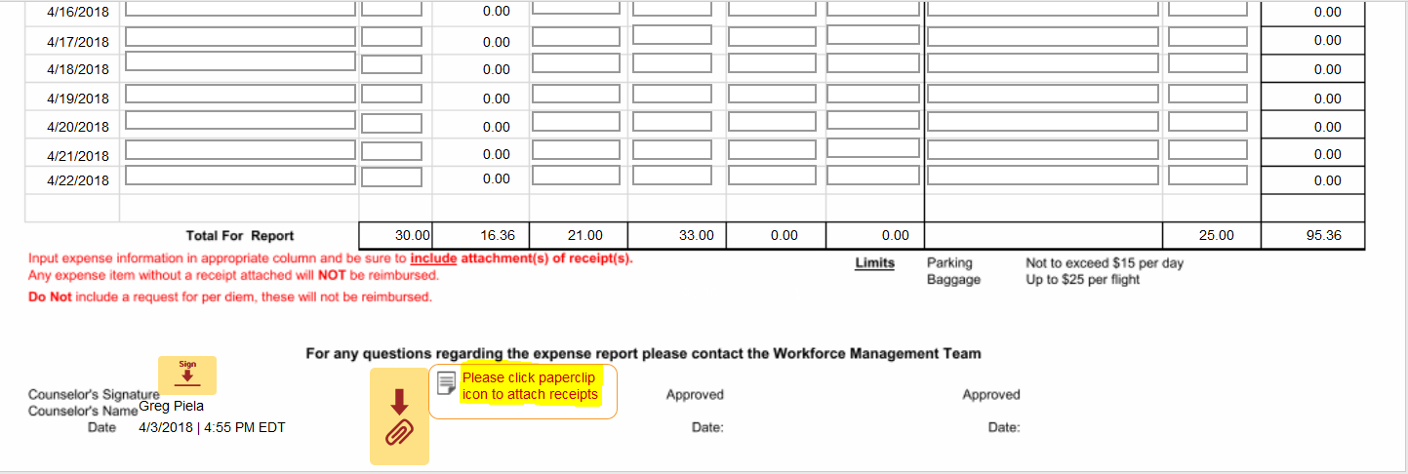
Completing Your Expense Report: Attach Receipts & Finish
After you have entered all of your expense line items:
Attach corresponding receipts by clicking on the paperclip icon as highlighted below
Once all receipts have been attached click on “Sign”
To submit your expense report for review click on “Finish”
An email will be sent to the WFM Team to do a preliminary review of the expenses and receipts submitted. Upon preliminary approval the Expense Report is sent to Accounts Payable and Finance for the further review. Once approved it will be submitted for processing and sent to your bank for direct deposit.

Slide 8

Questions?

